Slide 1

Insights of CNN and ViT

Slide 2
Detecting Tuberculosis-Consistent Findings in Lateral Chest X-Rays Using an Ensemble of CNNs and Vision Transformers
CNN:
Detailed feature extraction
Transformer:
Overall understanding and spatial relationship
https://www.frontiersin.org/journals/genetics/articles/10.3389/fgene.2022.864724/full

Slide 3
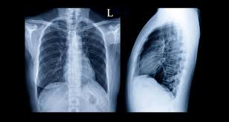
Lateral chest x-ray
Frontal (PosteriorAnterior, AnteriorPosterior)
Lateral
The World Health Organization (WHO) recommends the use of lateral CXR projections to identify mediastinal or hilar lymphadenopathy (World Health Organization, 2016), especially in younger children with primary TB where a bacteriological confirmation might be challenging

Slide 4
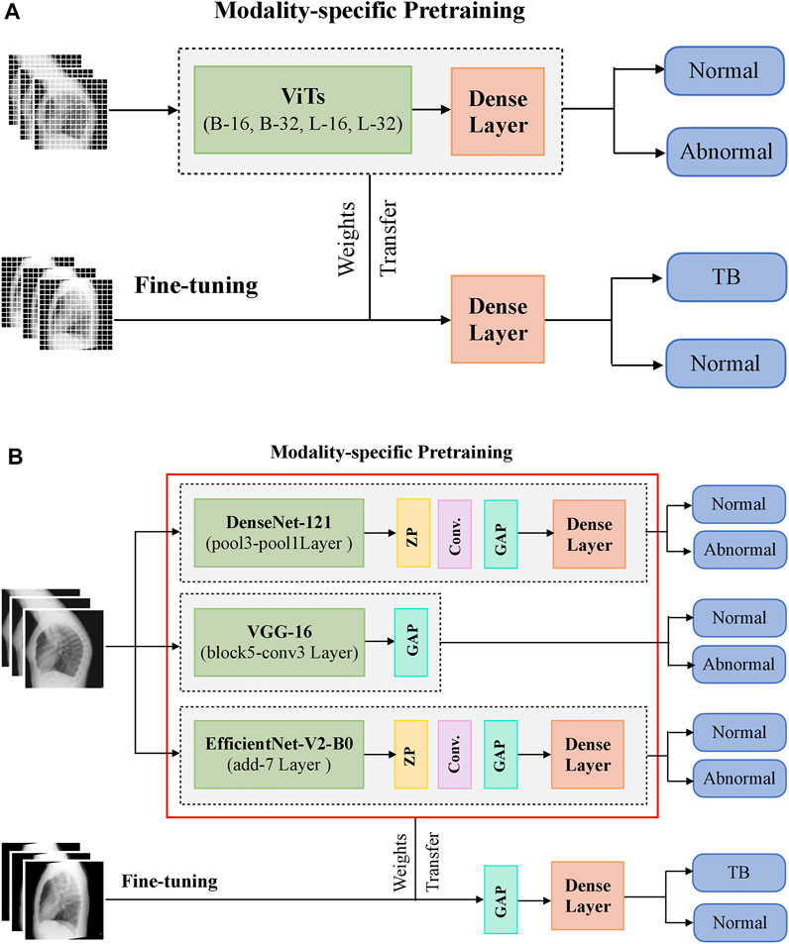
Working

Slide 5
Methodology
Ensemble Learning:
Prediction of CNNs + Prediction of Vision Transformer
Chest X-ray
Classification Model:
VGG-16
DenseNet-121
EfficientNet-V2-B0
ViT-Base (B)/16
ViT-B/32
ViT-Large (L)/16
Local Features
Edges and Contours
Textures
Small Anomalies
Global Features
Shape and Size
Spatial Relationships

